Slide 1

Cutting Through Privacy: A Hyperplane-Based Data Reconstruction Attack in Federated Learning
Francesco Diana, André Nusser, Chuan Xu, Giovanni Neglia
28/05/2025

Slide 2
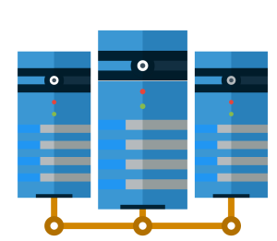
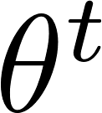

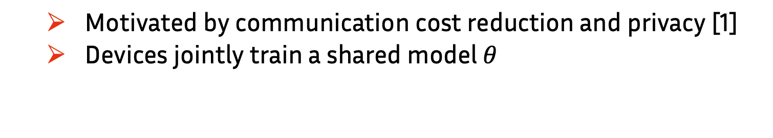
Federated Learning (FL)
Motivated by communication cost reduction and privacy [1]
Devices jointly train a shared model $θ$
[1] McMahan, B.; Moore, E.; Ramage, D.; Hampson, S.; and Agüera y Arcas, B. 2017. Communication-efficient learning of deep networks from decentralized data. In Artificial Intelligence and Statistics,1273–1282. PMLR
Notes:
First, let’s introduce Federated learning, which is a distributed learning paradigm where a set of clients collaborate with a central server to train a shared model. This work was initially motivated by communication cost reduction, asa we don’t need to transmit all the data, but only updates.
The goal is to minimize a global loss that is obtained as weighted sum of the loss of each client on her local dataset Sc.

Slide 3
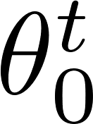
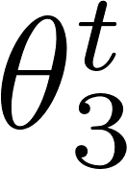
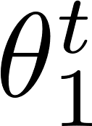
Federated Learning (FL)
Motivated by communication cost reduction and privacy [1]
Devices jointly train a shared model $θ$
[1] McMahan, B.; Moore, E.; Ramage, D.; Hampson, S.; and Agüera y Arcas, B. 2017. Communication-efficient learning of deep networks from decentralized data. In Artificial Intelligence and Statistics,1273–1282. PMLR
Notes:
Federated learning is a distributed learning paradigm where a set of clients collaborate with a central server to train a shared model. This work was initially motivated by communication cost reduction, asa we don’t need to transmit all the data, but only updates.
The goal is to minimize a global loss that is obtained as weighted sum of the loss of each client on her local dataset Sc.

Slide 4
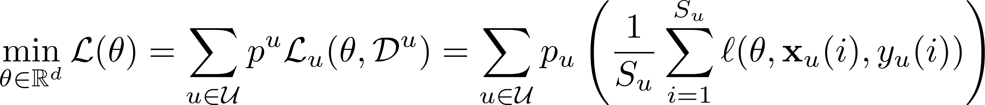
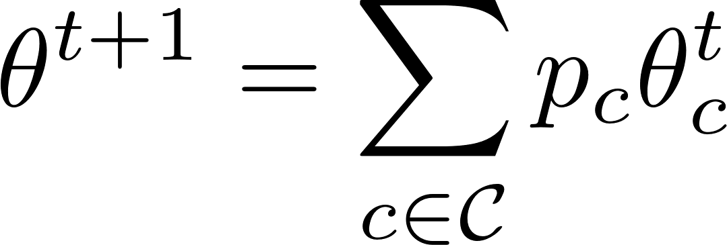
Federated Learning (FL)
Motivated by communication cost reduction and privacy [1]
Devices jointly train a shared model $θ$
[1] McMahan, B.; Moore, E.; Ramage, D.; Hampson, S.; and Agüera y Arcas, B. 2017. Communication-efficient learning of deep networks from decentralized data. In Artificial Intelligence and Statistics,1273–1282. PMLR
Notes:
Federated learning is a distributed learning paradigm where a set of clients collaborate with a central server to train a shared model. This work was initially motivated by communication cost reduction, asa we don’t need to transmit all the data, but only updates.
The goal is to minimize a global loss that is obtained as weighted sum of the loss of each client on her local dataset Sc.

Slide 5
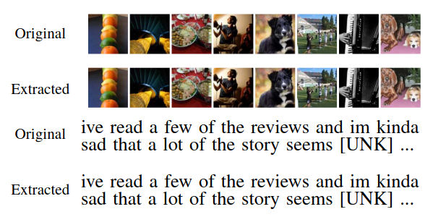
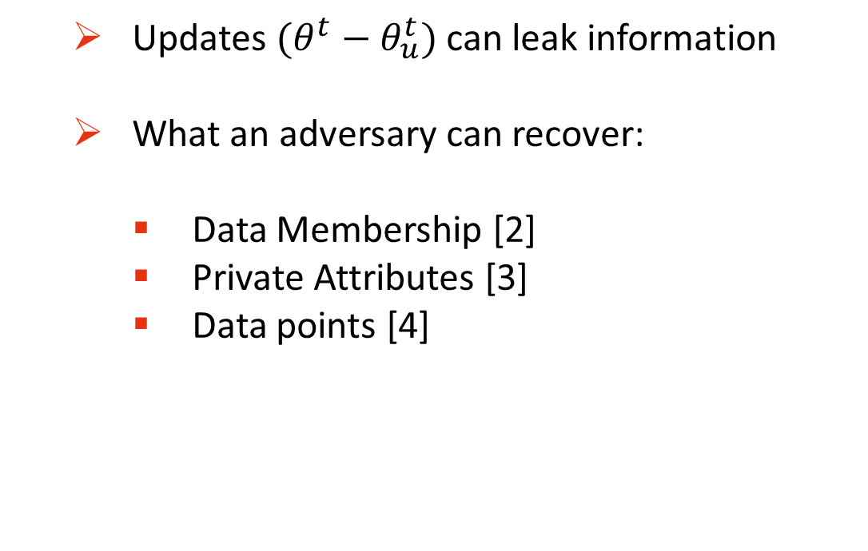
Is FL really private?
Updates $(θ^{t}−θ_{u}^{t})$can leak information
What an adversary can recover:
Data Membership [2]
Private Attributes [3]
Data points [4]
Figure: sample reconstruction attack from [4]
[2] Nasr, M.; Shokri, R.; and Houmansadr, A. 2019. Comprehensive privacy analysis of deep learning: Passive and active white-box inference attacks against centralized and federated learning. In 2019 IEEE Symposium on Security and Privacy (SP), 739–753. IEEE
[3] Diana, F., Marfoq, O., Xu, C., Neglia, G., Giroire, F., & Thomas, E. (2025). Attribute Inference Attacks for Federated Regression Tasks. Proceedings of the AAAI Conference on Artificial Intelligence, 39(15), 16271-16279.
[4] Boenisch, F.; Dziedzic, A.; Schuster, R.; Shamsabadi, A. S.; Shumailov, I.; and Papernot, N. 2023. When the Curious Abandon Honesty: Federated Learning Is Not Private. In2023 IEEE 8th European Symposium on Security and Privacy (EuroS&P), 175–199.
Notes:
For example, imagine to train a regression model for a drug dosage prediction task. Sensitive attributes that might not be disclosed can be binary attributes indicating a particular medical condition of a patient or some specific gene.

Slide 6
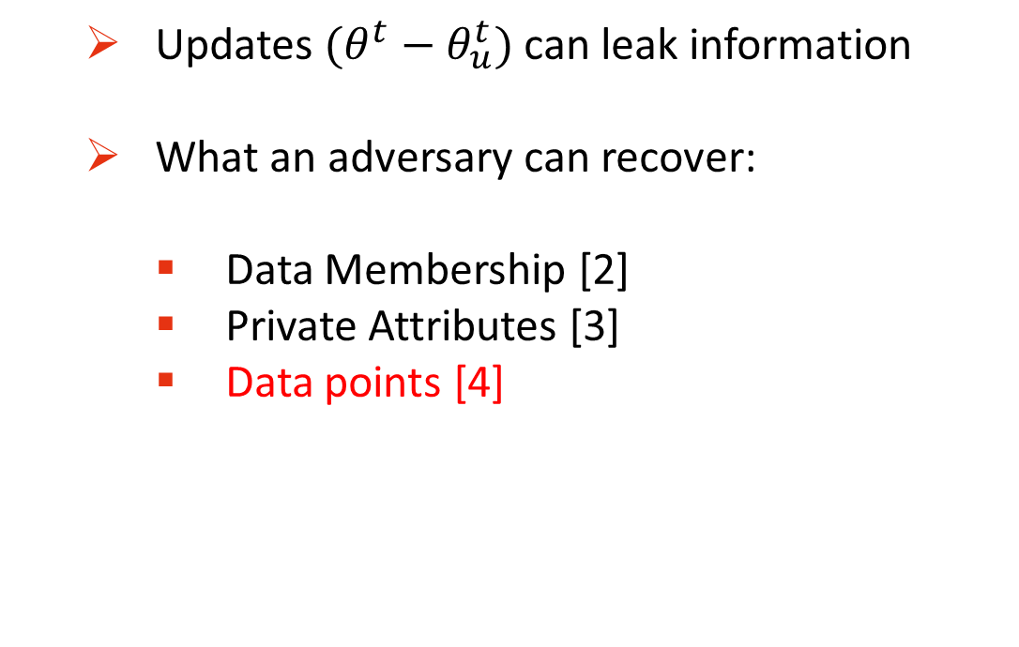
Today’s talk
Updates $(θ^{t}−θ_{u}^{t})$can leak information
What an adversary can recover:
Data Membership [2]
Private Attributes [3]
Data points [4]
Figure: sample reconstruction attack from [4]
[2] Nasr, M.; Shokri, R.; and Houmansadr, A. 2019. Comprehensive privacy analysis of deep learning: Passive and active white-box inference attacks against centralized and federated learning. In 2019 IEEE Symposium on Security and Privacy (SP), 739–753. IEEE
[3] Diana, F., Marfoq, O., Xu, C., Neglia, G., Giroire, F., & Thomas, E. (2025). Attribute Inference Attacks for Federated Regression Tasks. Proceedings of the AAAI Conference on Artificial Intelligence, 39(15), 16271-16279.
[4] Boenisch, F.; Dziedzic, A.; Schuster, R.; Shamsabadi, A. S.; Shumailov, I.; and Papernot, N. 2023. When the Curious Abandon Honesty: Federated Learning Is Not Private. In2023 IEEE 8th European Symposium on Security and Privacy (EuroS&P), 175–199.

Slide 7
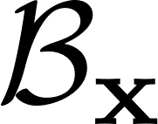
Prior Data Reconstruction Attacks
Goal: reconstruct client’s input batch
Two families of attacks:
Optimization-based [5]
Analytical [4]
[4] Boenisch, F.; Dziedzic, A.; Schuster, R.; Shamsabadi, A. S.; Shumailov, I.; and Papernot, N. 2023. When the Curious Abandon Honesty: Federated Learning Is Not Private. In2023 IEEE 8th European Symposium on Security and Privacy (EuroS&P), 175–199.
[5] Zhu, L., Liu, Z., & Han, S. (2019). Deep leakage from gradients. In Advances in Neural Information Processing Systems (Vol. 32).

Slide 8
Optimization-based attacks

Slide 9
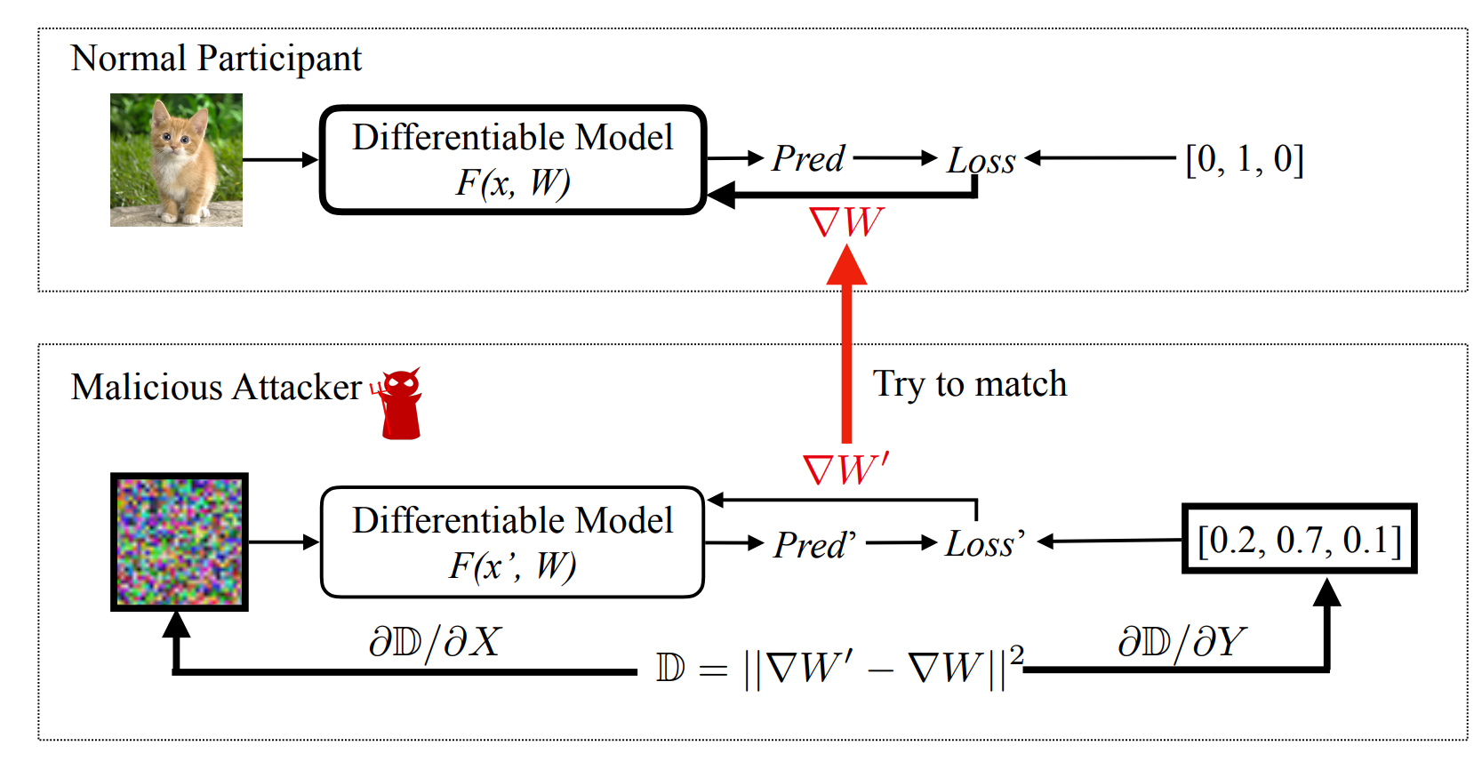

Optimization-based attacks
Figure: Optimization-based attack from [5].
[5] Zhu, L., Liu, Z., & Han, S. (2019). Deep leakage from gradients. In Advances in Neural Information Processing Systems (Vol. 32).

Slide 10
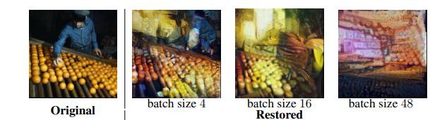
Optimization-based attacks
Limitations:
Work on small batches
Figure: Sample reconstruction from [6].
[6] H. Yin et al., "See through Gradients: Image Batch Recovery via GradInversion," in 2021 IEEE/CVF Conference on Computer Vision and Pattern Recognition (CVPR), Nashville, TN, USA, 2021, pp. 16332-16341,
Notes:
Problem: with larger batch we have a linear combination of all the inputs, so it is harder to decode the single image

Slide 11
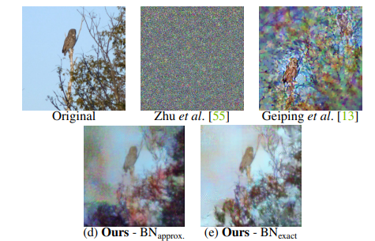
Optimization-based attacks
Limitations:
Work on small batches
“Challenging samples” not recoverable
Figure: Comparison of gradient inversion for batch size 1 from [6].
[6] H. Yin et al., "See through Gradients: Image Batch Recovery via GradInversion," in 2021 IEEE/CVF Conference on Computer Vision and Pattern Recognition (CVPR), Nashville, TN, USA, 2021, pp. 16332-16341,

Slide 12
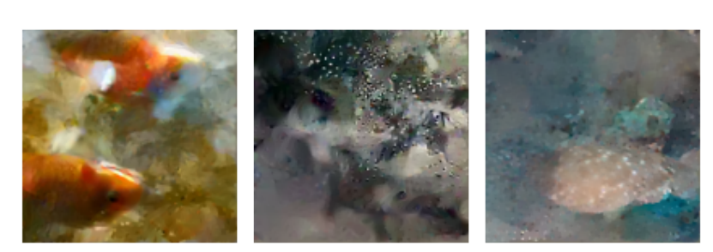
Optimization-based attacks
What if the attacker is active?
Figure: Reconstruction example from a batch of 256 images [7].
[7] Wen, Y., Geiping, J., Fowl, L.H., Goldblum, M., & Goldstein, T. (2022). Fishing for User Data in Large-Batch Federated Learning via Gradient Magnification, Proceedings of the 39th International Conference on Machine Learning, PMLR 162:23668-23684.
Notes:
Performance improved, but require additional data assumptions. The idea here is to modify the model parameters in such a way to isolate the gradient of a single input in the batch.

Slide 13
Analytical attacks

Slide 14
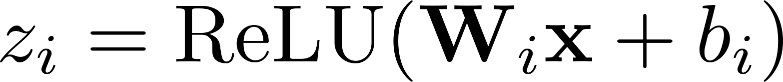
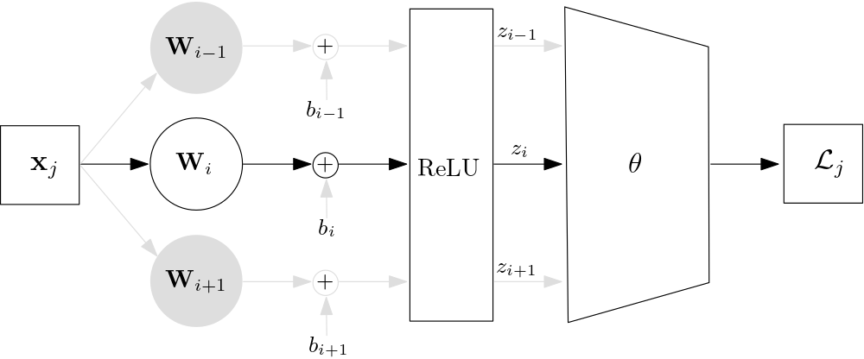
An interesting property
Linear layers followed by ReLU naturally leak information [8]
[8] Geiping, J., Bauermeister, H., Dröge, H., & Moeller, M. (2020). Inverting gradients - how easy is it to break privacy in federated learning? In Proceedings of the 34th International Conference on Neural Information Processing Systems
Notes:
Forward propagation

Slide 15
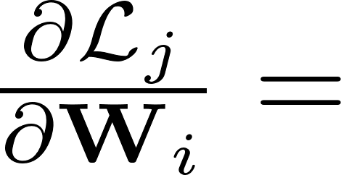
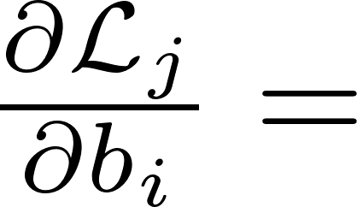
An interesting property
Linear layers followed by ReLU naturally leak information [9]
[8] Geiping, J., Bauermeister, H., Dröge, H., & Moeller, M. (2020). Inverting gradients - how easy is it to break privacy in federated learning? In Proceedings of the 34th International Conference on Neural Information Processing Systems
Notes:
What the server has access to

Slide 16
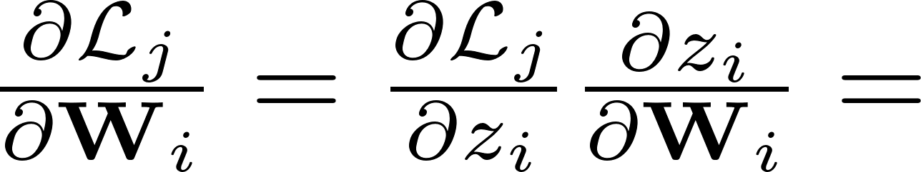
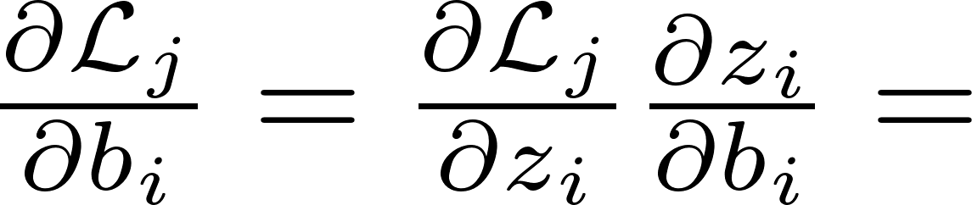
An interesting property
Linear layers followed by ReLU naturally leak information [9]
[8] Geiping, J., Bauermeister, H., Dröge, H., & Moeller, M. (2020). Inverting gradients - how easy is it to break privacy in federated learning? In Proceedings of the 34th International Conference on Neural Information Processing Systems
Notes:
Chain rule

Slide 17
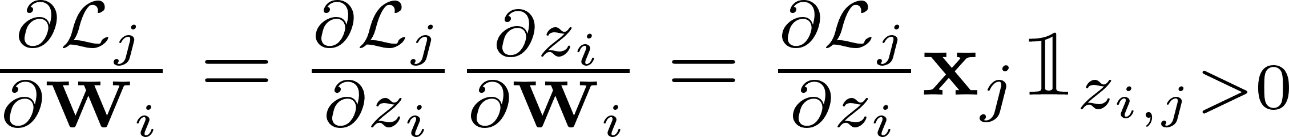
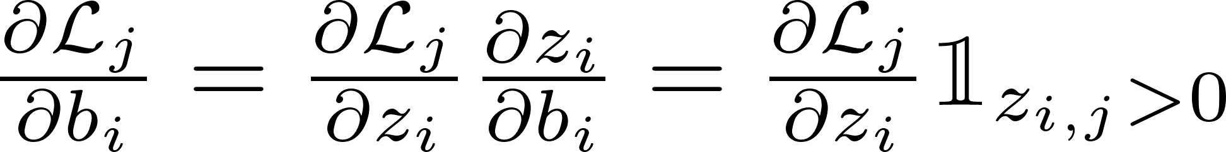
An interesting property
Linear layers followed by ReLU naturally leak information [9]
[8] Geiping, J., Bauermeister, H., Dröge, H., & Moeller, M. (2020). Inverting gradients - how easy is it to break privacy in federated learning? In Proceedings of the 34th International Conference on Neural Information Processing Systems
Notes:
dz_i/db_i = 1
Indicator function because of relu

Slide 18
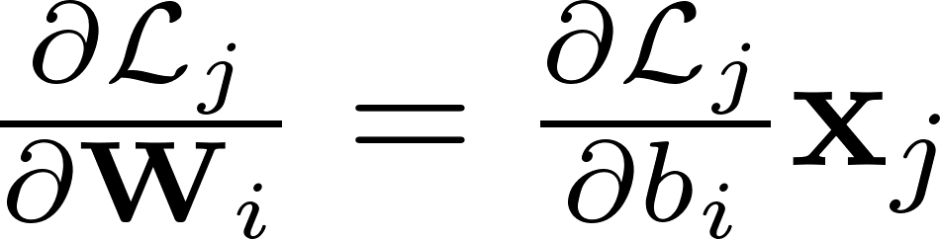
An interesting property
Linear layers followed by ReLU naturally leak information [9]
we can
reconstruct x_{j}!
[8] Geiping, J., Bauermeister, H., Dröge, H., & Moeller, M. (2020). Inverting gradients - how easy is it to break privacy in federated learning? In Proceedings of the 34th International Conference on Neural Information Processing Systems
Notes:
If the linear layer is the first layer of the network, we can recover the input

Slide 19
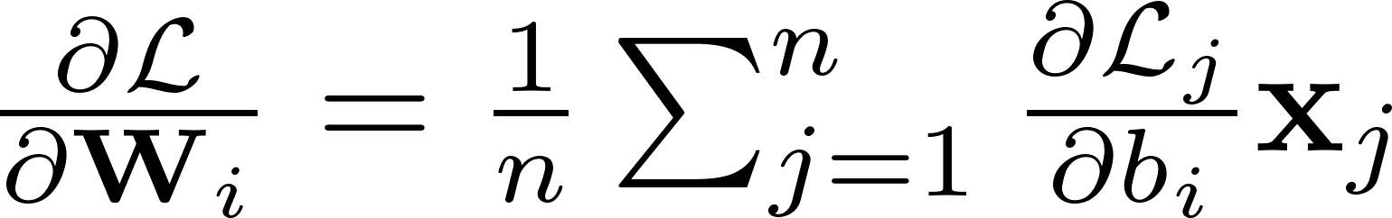
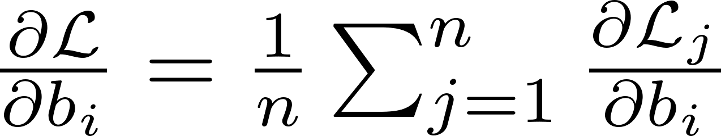
A more realistic scenario
Gradients are computed on batches.
The attacker observes:

Slide 20
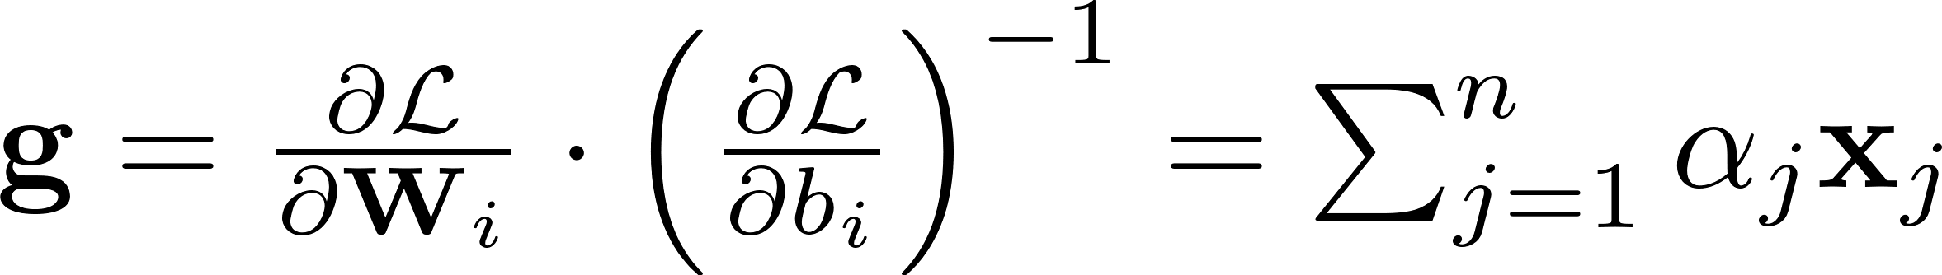
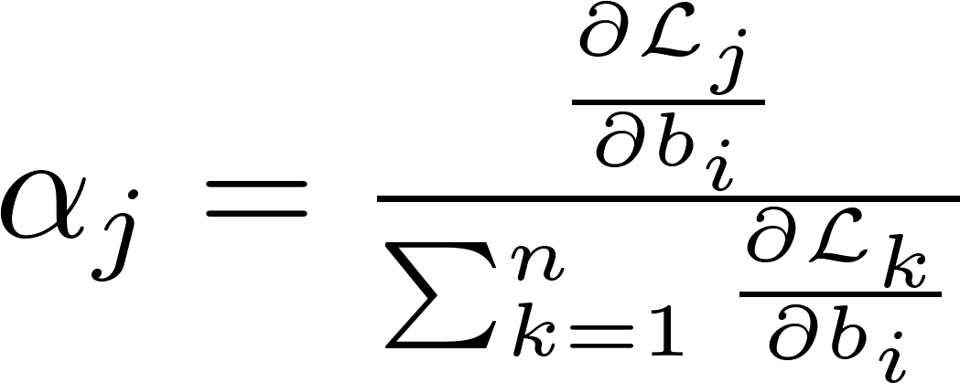
A more realistic scenario
Gradients are computed on batches
The attacker observes:
And recovers:

Slide 21
Existing analytical attacks
Malicious server
Require prior knowledge on dataset
Two threat models:
Parameters modifications (Sparsity-based) [4]
Architectural changes [9]
[4] Boenisch, F.; Dziedzic, A.; Schuster, R.; Shamsabadi, A. S.; Shumailov, I.; and Papernot, N. 2023. When the Curious Abandon Honesty: Federated Learning Is Not Private. In2023 IEEE 8th European Symposium on Security and Privacy (EuroS&P), 175–199.
[9] Fowl, L., Geiping, J., Czaja, W., Goldblum M., & Goldstein, T. (2022). Robbing the fed: Directly obtaining private data in federated learning with modified models. In International Conference on Learning Representations

Slide 22
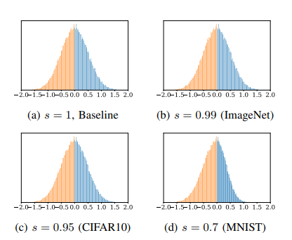
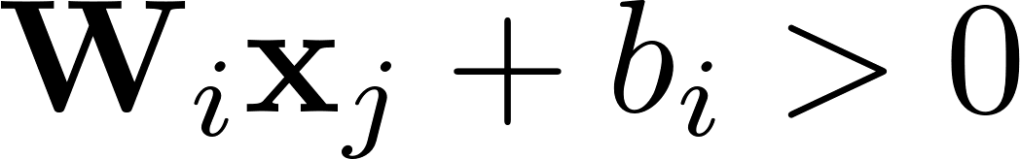
Sparsity-based attacks
Exploit sparseness induced by the ReLU
Batch
Figure: $W_{i}$ distribution from [4]
[4] Boenisch, F.; Dziedzic, A.; Schuster, R.; Shamsabadi, A. S.; Shumailov, I.; and Papernot, N. 2023. When the Curious Abandon Honesty: Federated Learning Is Not Private. In2023 IEEE 8th European Symposium on Security and Privacy (EuroS&P), 175–199.
Notes:
S is a scaling factor. Each component is picked from a gaussian distribution

Slide 23
Our contributions

Slide 24
Contributions
Analytical upper bound on the accuracy of existing sparsity-based attacks on random data

Slide 25
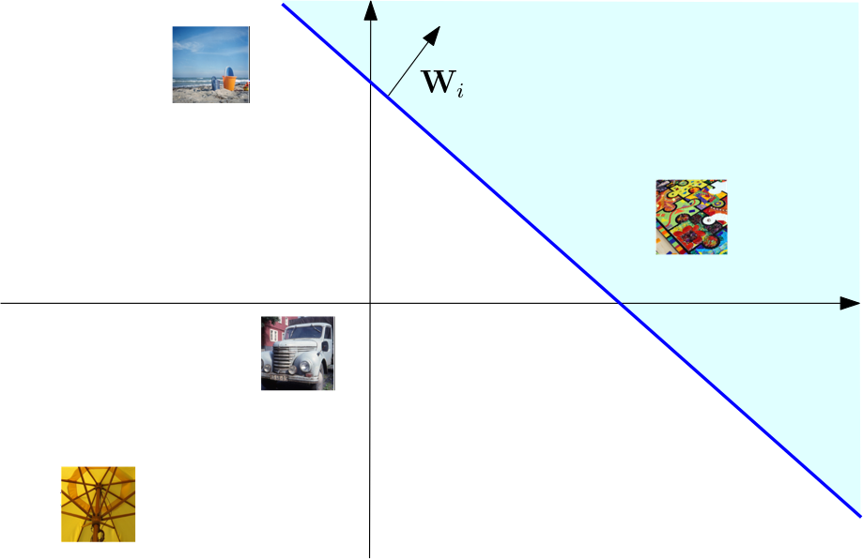
Geometric interpretation
Exploit sparseness induced by the ReLU
Batch
Notes:
Previous attack from this perspective

Slide 26
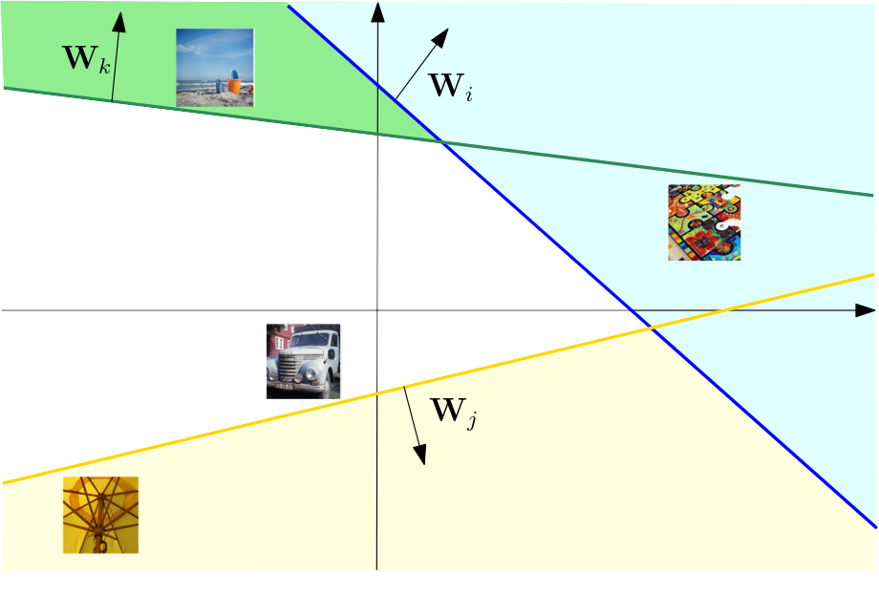
Limitations
Only vertices of the convex hull can be recovered
Notes:
No matter how many directions or rounds we use to attack

Slide 27
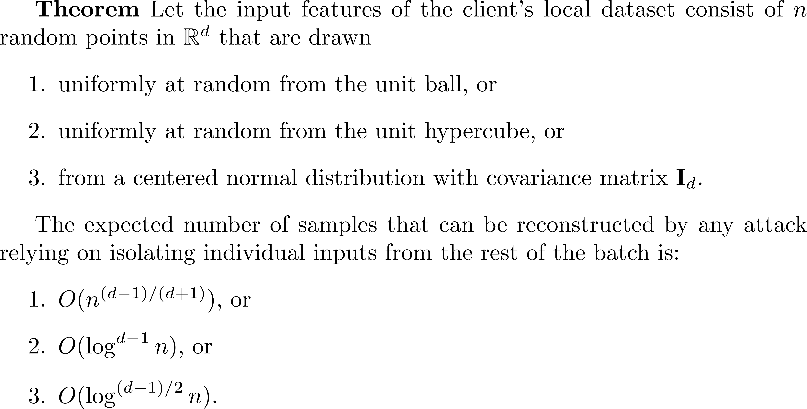
Limitations
fraction of reconstructable inputs
vanishes as n diverges

Slide 28
Contributions
Analytical upper bound on the accuracy of existing data reconstruction attacks on random data
A perfect reconstruction algorithm for classification tasks without any prior knowledge on dataset
Notes:
Remark that other attacks require prior knowledge

Slide 29
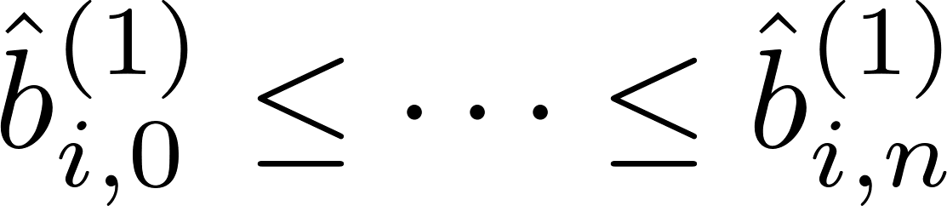
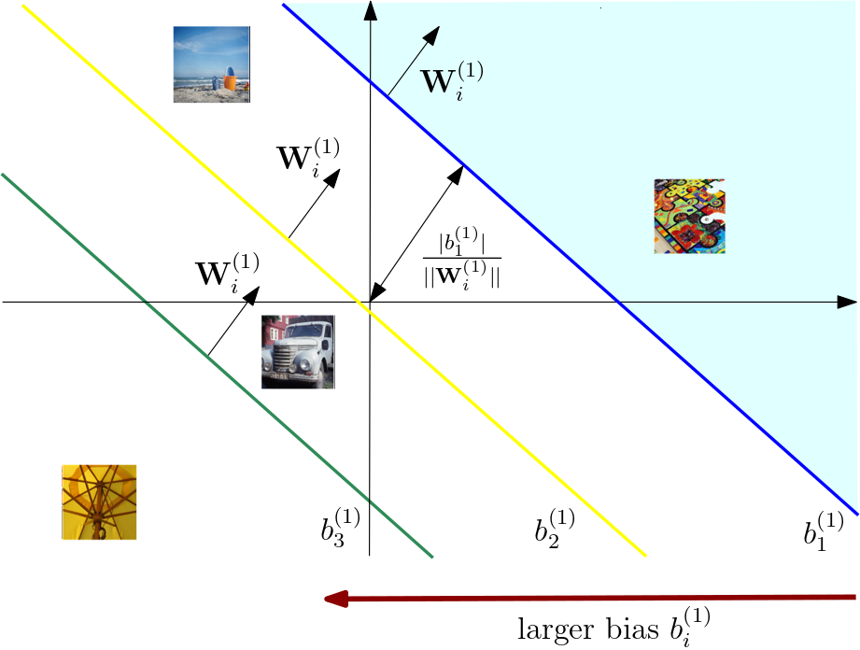
Intuition
Translate the hyperplane to sequentially isolate inputs
Find a series of bias values
Notes:
Say that we focus on one neuron, I, at different communication rounds he can send different hyperplanes to have eventually a series of bias values

Slide 30
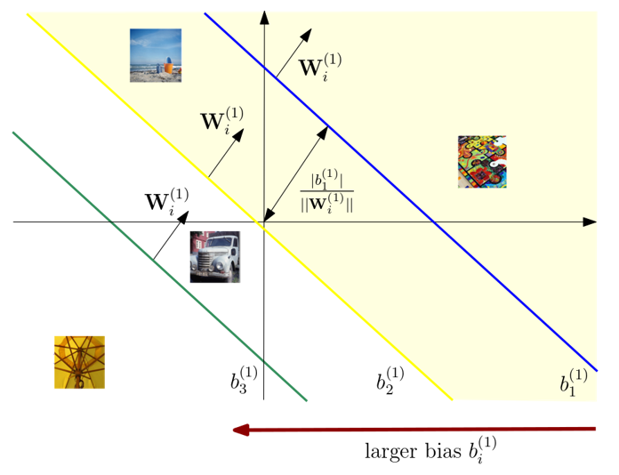
Intuition
Translate the hyperplane to sequentially isolate inputs
Find a series of bias values

Slide 31
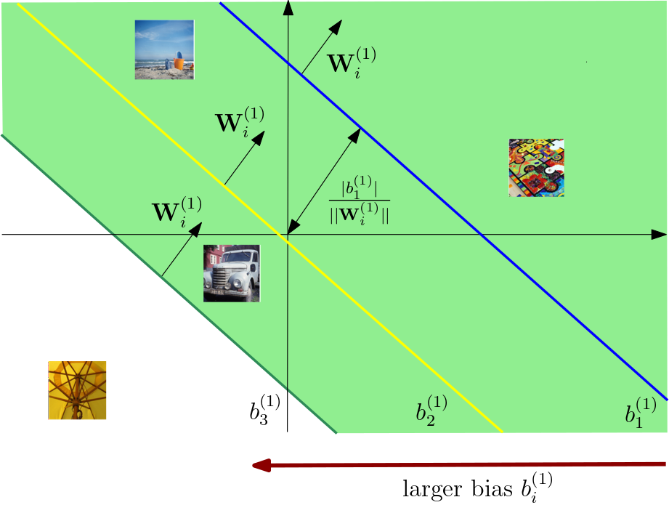
Intuition
Translate the hyperplane to sequentially isolate inputs
Find a series of bias values

Slide 32
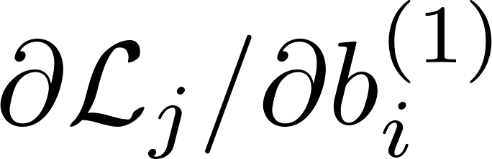
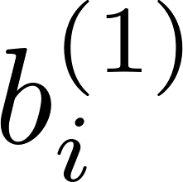
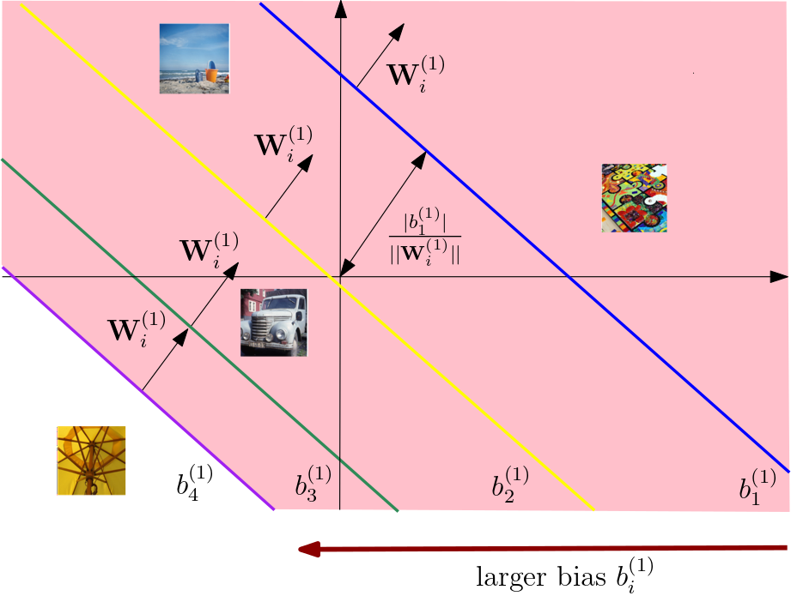

Locate the inputs
Assume independent of once neuron i is activated by x_{j}
Notes:
In this case we do not make assumption on the type of the model, and we can consider a generale neural network model.

Slide 33
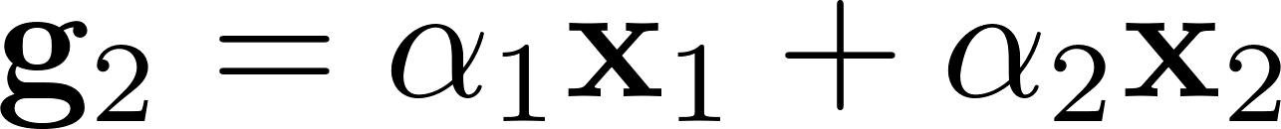
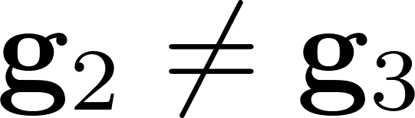
Locate the inputs
Assume independent of once neuron i is activated by x_{j}
Notes:
In this case we do not make assumption on the type of the model, and we can consider a generale neural network model.

Slide 34
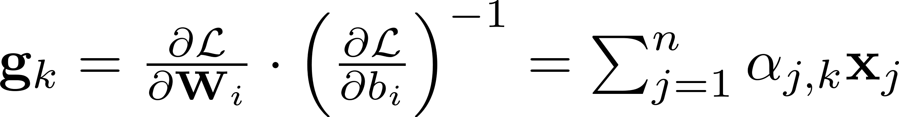
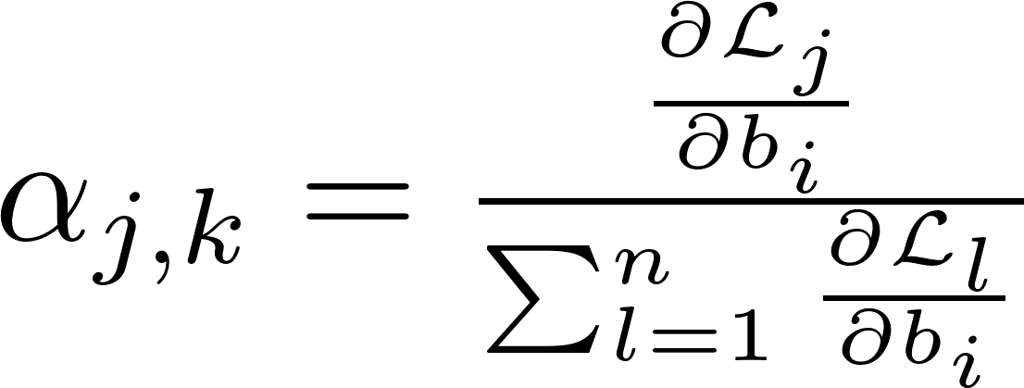

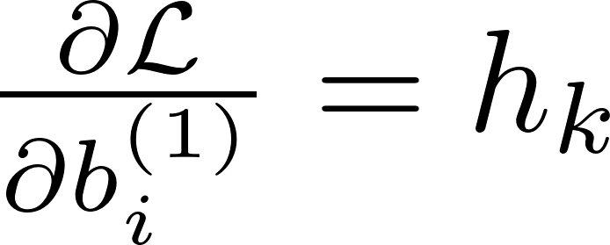
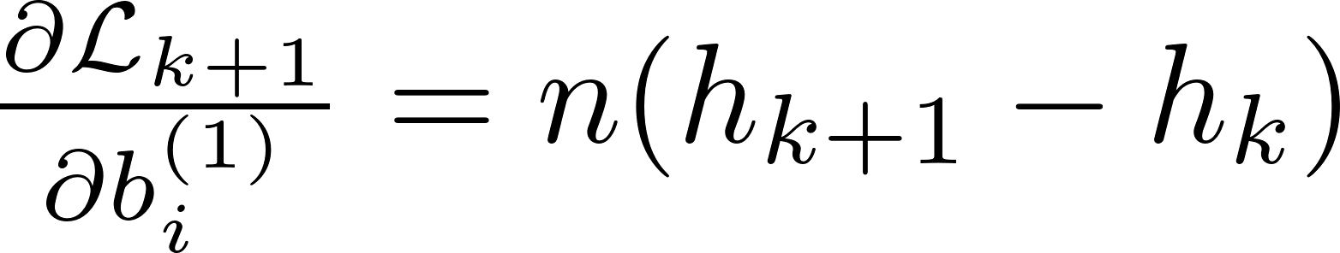
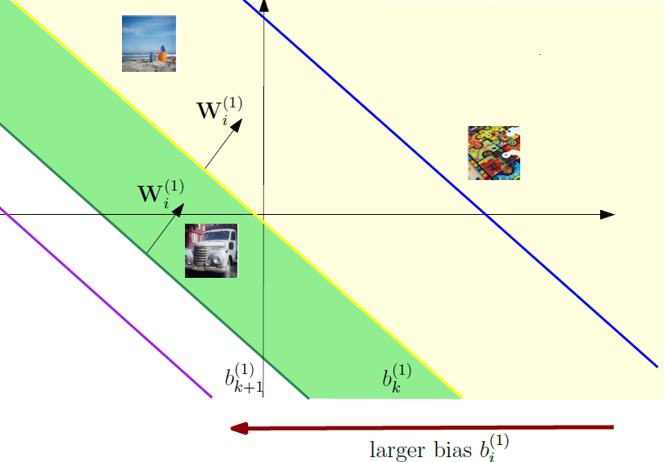
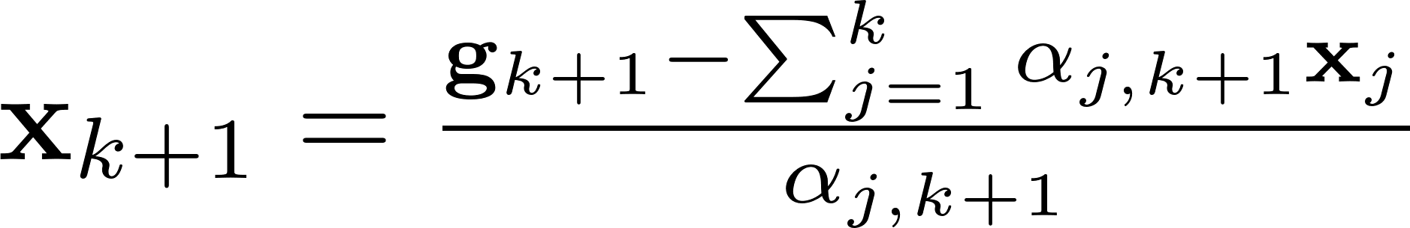
Reconstruct the inputs
Assume independent of once neuron i is activated by x_{j}
Suppose we recovered the first inputs
And then
Notes:
Now, we assume that we have located all the hyperplanes, such that each image is isolated
Kth reconstruction, image j

Slide 35
Contributions
Analytical upper bound on the accuracy of existing data reconstruction attacks on random data.
A perfect reconstruction algorithm for classification tasks
We show how a malicious server can control each data point's contribution to the client's updates
Notes:
In this case we do not make assumption on the type of the model, and we can consider a generale neural network model.

Slide 36
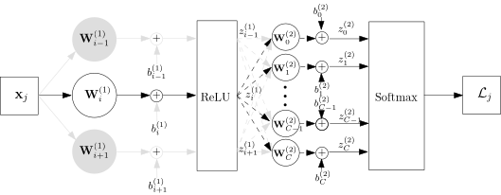


Control the gradients
Consider the cross-entropy loss
From simple calculations
where
Assume independent of once neuron i is activated by x_{j}
Notes:
We made the assumption, and now we want it to relax
This means that if we move the hyperplanes and we do not see any new input, the alpha coefficients remain the same

Slide 37

Control the gradients
Consider the cross-entropy loss
From simple calculations
where
By setting large bias value in the second layer:
Notes:
We need to fix the same column of W2 and repeat it.

Slide 38


Algorithm
1. Server sets malicious weights
Notes:
Suppose our first layer has 4 neurons

Slide 39


Algorithm
2. Server computes observations
Notes:
Keep g values

Slide 40
Algorithm
3. Update the search state
Notes:
In this case we do not make assumption on the type of the model, and we can consider a generale neural network model.

Slide 41

Algorithm
4. Keep searching
Notes:
Put dashed line for previous round, add animation for crosses

Slide 42

Algorithm
5. Reconstruct the input
Notes:
Move a bit the hyperplanes (not required to be in the middle) and fix the notation

Slide 43


Results
Experiments on ImageNet
FedSGD with full-batch update
Baseline is [4]
Figure: Results after 10 communication rounds
Figure: Accuracy difference respect to the baseline (CAH)[4]
[4] Boenisch, F.; Dziedzic, A.; Schuster, R.; Shamsabadi, A. S.; Shumailov, I.; and Papernot, N. 2023. When the Curious Abandon Honesty: Federated Learning Is Not Private. In2023 IEEE 8th European Symposium on Security and Privacy (EuroS&P), 175–199.
Notes:
Say how we compare fairly to baseline

Slide 44

Results
Figure: Reconstructions from a batch of 1024 images.
Notes:
In this case we do not make assumption on the type of the model, and we can consider a generale neural network model.

Slide 45


Results
Results on HARUS
Figure: Results after 50 communication rounds.
Figure: Accuracy difference respect to the baseline (CAH)[4]
[4] Boenisch, F.; Dziedzic, A.; Schuster, R.; Shamsabadi, A. S.; Shumailov, I.; and Papernot, N. 2023. When the Curious Abandon Honesty: Federated Learning Is Not Private. In2023 IEEE 8th European Symposium on Security and Privacy (EuroS&P), 175–199.
Notes:
Remind limitation of other papers using the bound

Slide 46
Conclusions and Future works
Proposed a novel data reconstruction attack
Showed limitations of existing attacks
Successfully recover batches of arbitrary large size
Adapt to different tasks
Reduce model modifications
Notes:
In this case we do not make assumption on the type of the model, and we can consider a generale neural network model.

Slide 47
Thank You!

Slide 48
References
[1] McMahan, B.; Moore, E.; Ramage, D.; Hampson, S.; and Agüera y Arcas, B. 2017. Communication-efficient learning of deep networks from decentralized data. In Artificial Intelligence and Statistics,1273–1282. PMLR
[2] Nasr, M.; Shokri, R.; and Houmansadr, A. 2019. Comprehensive privacy analysis of deep learning: Passive and active white-box inference attacks against centralized and federated learning. In 2019 IEEE Symposium on Security and Privacy (SP), 739–753. IEEE
[3] Diana, F., Marfoq, O., Xu, C., Neglia, G., Giroire, F., & Thomas, E. (2025). Attribute Inference Attacks for Federated Regression Tasks. Proceedings of the AAAI Conference on Artificial Intelligence, 39(15), 16271-16279.
[4] Boenisch, F.; Dziedzic, A.; Schuster, R.; Shamsabadi, A. S.; Shumailov, I.; and Papernot, N. 2023. When the Curious Abandon Honesty: Federated Learning Is Not Private. In2023 IEEE 8th European Symposium on Security and Privacy (EuroS&P), 175–199.

Slide 49
References
[5] Zhu, L., Liu, Z., & Han, S. (2019). Deep leakage from gradients. In Advances in Neural Information Processing Systems (Vol. 32).
[6] H. Yin et al., "See through Gradients: Image Batch Recovery via GradInversion," in 2021 IEEE/CVF Conference on Computer Vision and Pattern Recognition (CVPR), Nashville, TN, USA, 2021, pp. 16332-16341,
[7] Wen, Y., Geiping, J., Fowl, L.H., Goldblum, M., & Goldstein, T. (2022). Fishing for User Data in Large-Batch Federated Learning via Gradient Magnification.
[8] Geiping, J., Bauermeister, H., Dröge, H., & Moeller, M. (2020). Inverting gradients - how easy is it to break privacy in federated learning? In Proceedings of the 34th International Conference on Neural Information Processing Systems
[9] Fowl, L., Geiping, J., Czaja, W., Goldblum M., & Goldstein, T. (2022). Robbing the fed: Directly obtaining private data in federated learning with modified models. In International Conference on Learning Representations

Slide 50
Backup slides

Slide 51

Effect of multiple layers
Table: Accuracy of our attack and baseline [4] on ImageNet, for batch size 512

Slide 52



Results on CNNs
Table: Accuracy of our attack and baseline [4] on CIFAR 10

Slide 53



Multiple local steps

Slide 54


Noise effect
Notes:
We want a very large value fro dl/db, such that the noise is small compared to the gradient signal, and we can cut it out.

